Slide 1
Sponsor Logo
Title and Acknowledgements
GMU/Team Logo
Background, purpose, and introduction.
Keep it SIMPLE and explain why this is important or how it relates to people.
Keep this section so a smart 12 year old would understand and be interested.
Flow charts, codes, sample screen shots, analysis, pictures, graphs, things you built.
Conclusions, summaries, references, future study etc.…
You can start to increase the complexity of your material here.
Acknowledgements, References (if needed)

Slide 2
CYSE 493 Industry Sponsored Senior Design Project Poster Design and Format
Spring 2020:
Andy Powell, Gino Manzo, Rock Sabetto, Tom Winston

Slide 3
Assignments E06 – Poster (DRAFT) and E07 Poster (Final)
Use this briefing to help you design and create your poster
Submit your poster in PDF format to the Blackboard assignment

Slide 4
Poster Paper Guidance
Poster Paper: Text and Graphics that presents your project in visually interesting way
Clearly articulates- what you did, how you did it, and why you did it
Key Points:
Clarity of Content- key points articulated clearly and concisely (biggest detractor-too much text)
Visually Interesting- want viewers to notice and take interest
Be sure to acknowledge your sponsor/SME
Size: 36”x 48”; Landscape Format, 1 Page
Excellent poster example on next chart

Slide 5
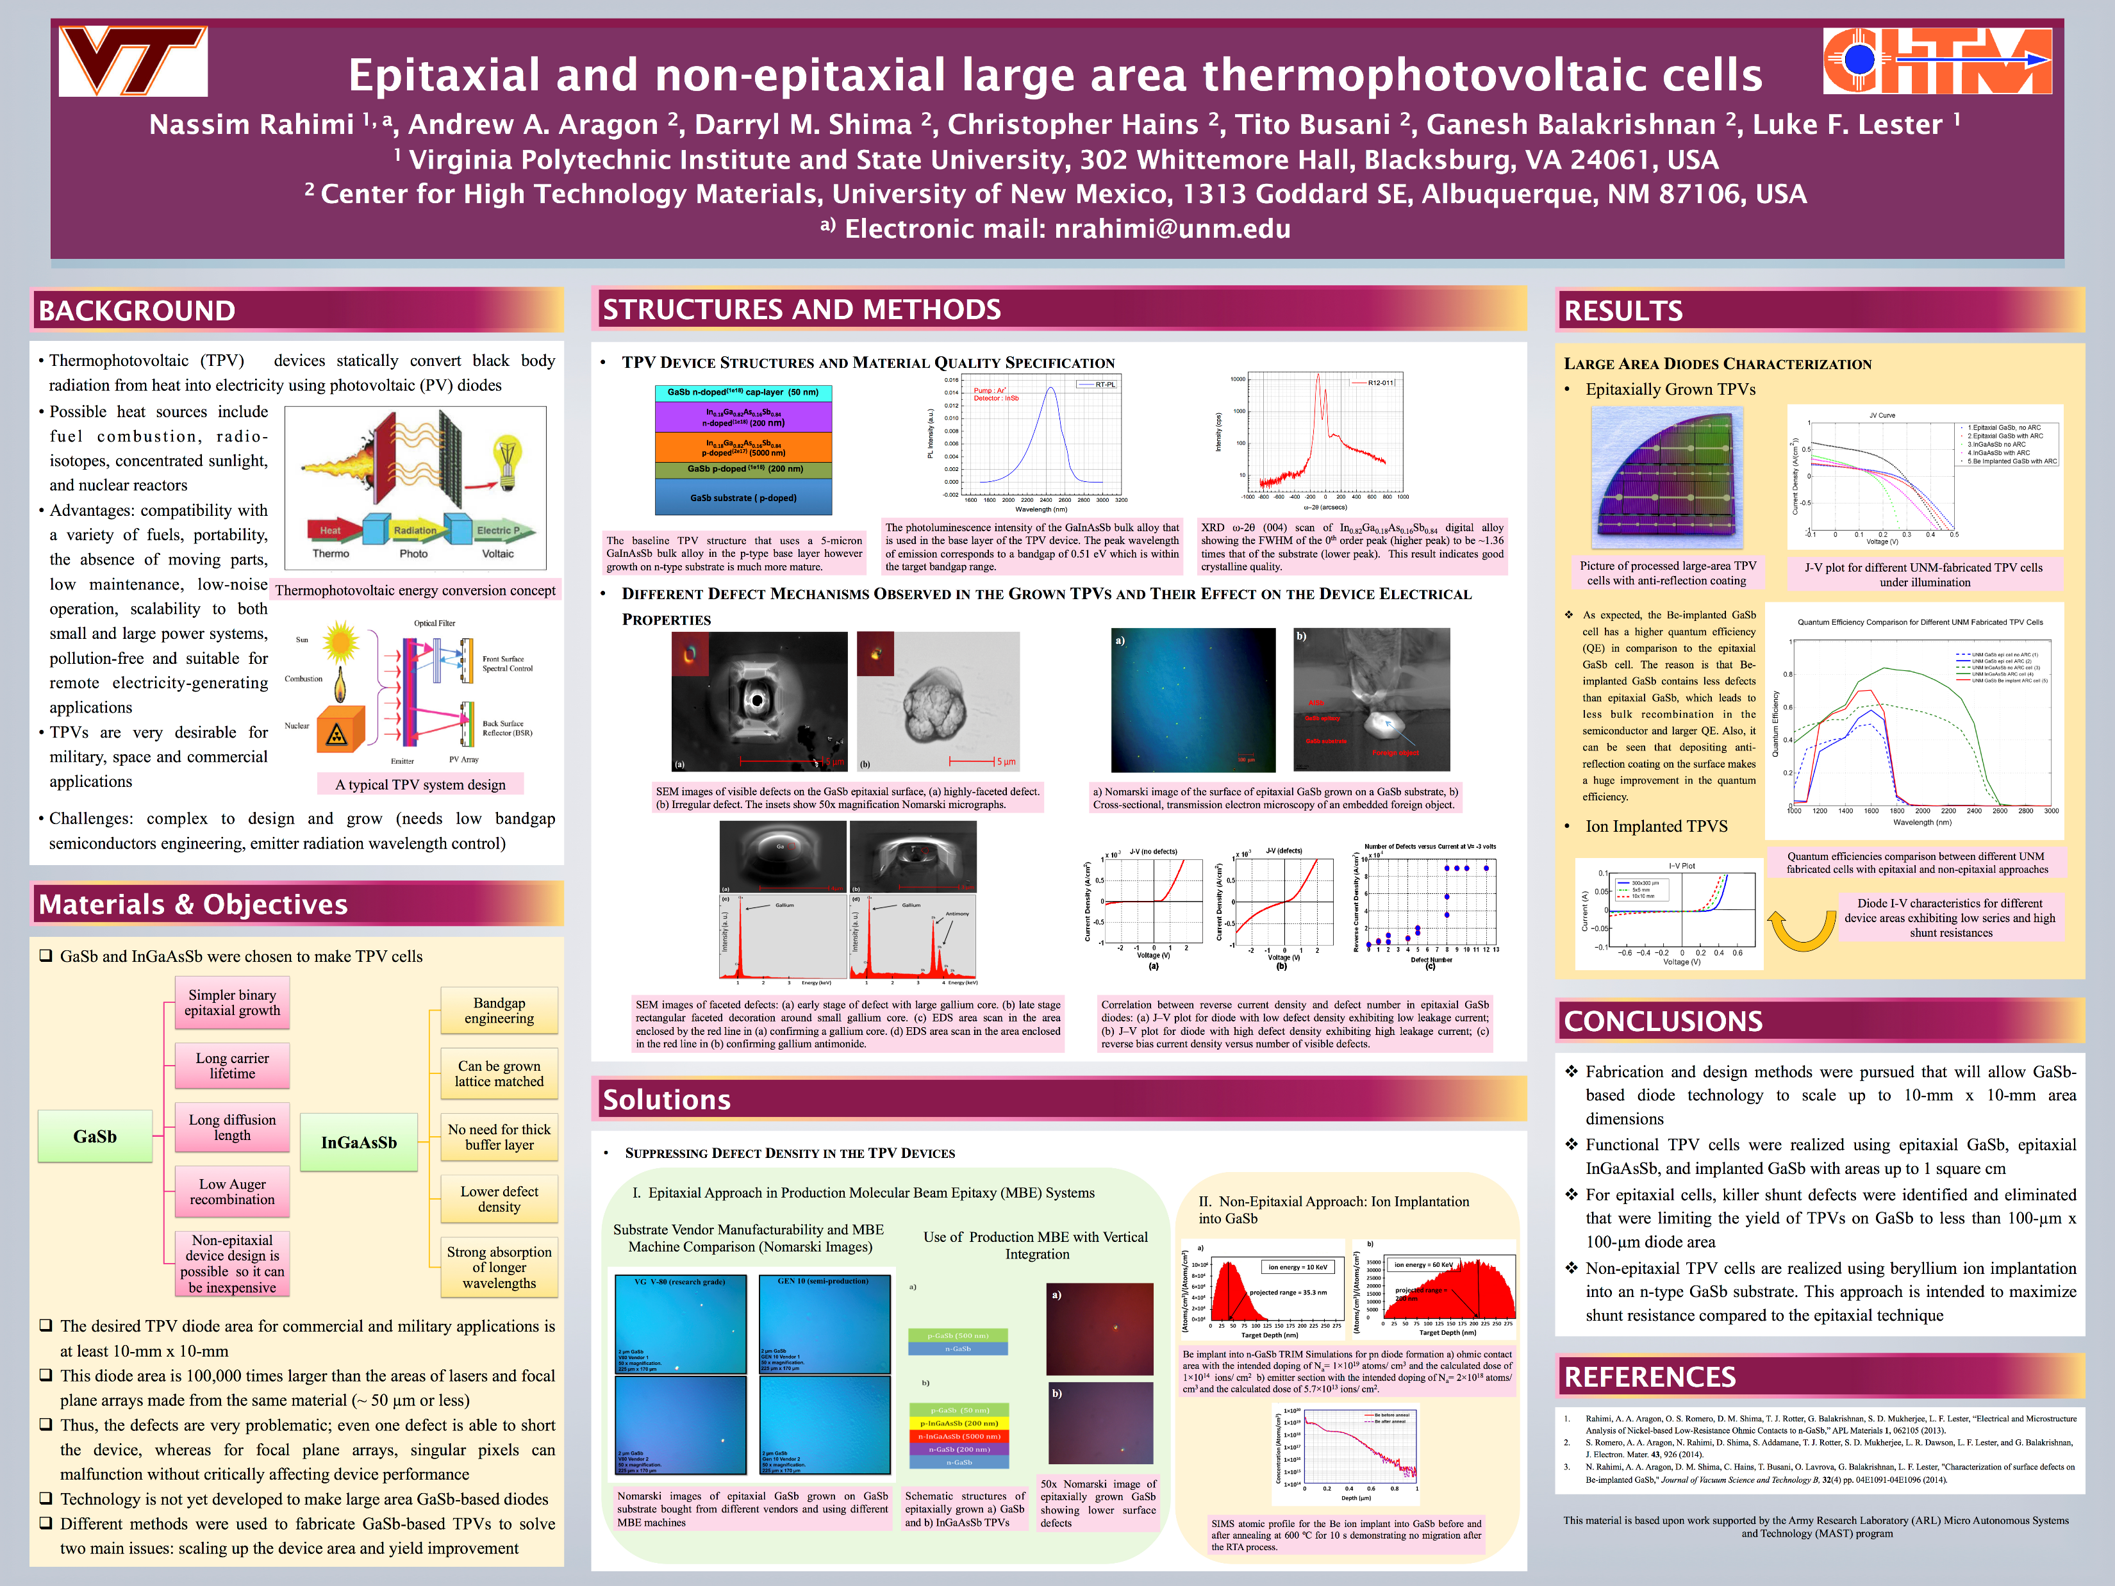

Slide 6
Layout Hints
Sponsor Logo
Title and Acknowledgements
GMU/Team Logo
Background, purpose, and introduction.
Keep it SIMPLE and explain why this is important or how it relates to people.
Keep this section so a smart 12 year old would understand and be interested.
Flow charts, codes, sample screen shots, analysis, pictures, graphs, things you built.
Conclusions, summaries, references, future study etc.…
You can start to increase the complexity of your material here.
Acknowledgements, References (if needed)

Slide 7
Research Poster Design Basics
Hannah McLaughlin, Scholarship Production Lab Coordinator

Slide 8
Why create a research poster?
They are used in many academic settings, such as classrooms and conferences.
They summarize your research concisely and visually communicate the information to the public.
A poster is an effective way to engage with new audiences and lead your field to further discussion.

Slide 9
Benefits of a research poster:
Can hang in your department for years
Can reach a broader audience than a paper or a talk

Slide 10
Three elements interact during a research poster presentation:
A) Presenter
Explains the project
Has a short oral summary prepared
Uses the poster as graphic support
Professional in dress and behavior

Slide 11
B) Poster
Tells a logical story about the project
Reads from top-to-bottom, left-to-right
Is neat, professional, and well-organized
Stands as an independent scholarly work

Slide 12
C) Audience
Interacts at three levels:
Distant: identifies topic, reads title and name
Grazer: understands topic, reads sections, graphs, and pictures
Captivated: understands project, goals and significance, methods and outcomes, reads text and references
Notes:
Make sure your poster appeals to all three types of audience members: your topic is easily identifiable, catchy title, your contact info is easily found; can be understood on it’s own; lots of graphs and pictures w/ captions.

Slide 13
Things to think about before you start:
Know your audience. Is your poster presentation for a general non-scholarly audience? Or is it for scholars in your field or a different field?
Keep the text brief and simple. Your poster should have a natural flow and should be self-explanatory. Your poster should be simple, coherent, and easy to view for the audience.

Slide 14
What are the main ideas of your research? A good way to get organized is to list the main ideas in order of importance. You should focus on your main topic throughout the poster. What is the one important thing you want your viewers to learn?
Start early. Don’t wait until the last minute. Designing a good poster takes time from the planning to the printing. You should also know where to stop in the designing stage. Don’t spend too much time editing an image in Photoshop.

Slide 15
Think of your poster as an illustrated abstract:
Why should people care?
What am I adding to current knowledge
What are my methods?
What did I find? What do I recommend?

Slide 16
What to include in your poster:
Title Section
Title of presentation, 96-140 point font, sentence case
Author (your) Name(s)
Your Customer and Company Logo
Your SME
George Mason University logo – logo.gmu.edu (usually in the upper left corner)
Body
50% text and 50% visuals (this can include pictures, maps, graphs, diagrams, or block text)
Sections (names can vary depending on your field, check research journals or posters in your field for examples): Introduction, Background, Methods, Results/Evidence, Discussion/Conclusion, Acknowledgements, Bibliography
Audience reads from top to bottom, left to right

Slide 17
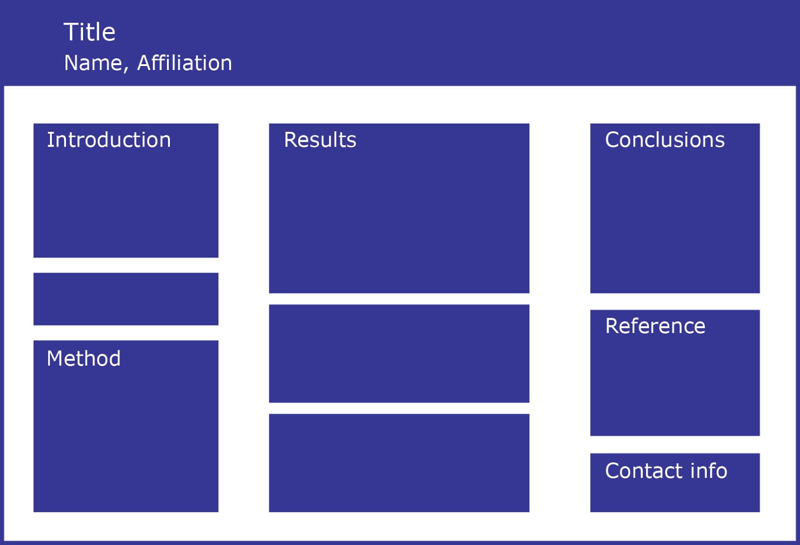
Example of Sections:

Slide 18
Choosing your Software:
PowerPoint
Easy to use, easily accessible
Lots of available templates
InDesign
Better quality
More Design features and functions
LaTex
High quality typesetting system
Takes some time to learn but freely available and lots of templates

Slide 19
Creating your Layout:
Set your page size in Page Setup before you start. Check with your conference about their allowable/preferred size, standard is 48” wide by 36” tall
Use Grids, Guides, and Rulers in the View menu of PowerPoint. Right click or control click (mac) to add more guides and create margins and columns. Use these as guides when adding text boxes for your title and body sections
Use columns to arrange your contents, most posters are designed with two to five columns depending on the size

Slide 20




Examples of column layouts:

Slide 21
Design tips:
Make your own style guide
Use a standard method for each type of text. Note the colors, italics, bold, and other treatments you are using for each type of text. Use a standard method for each type of text:
Title text (72-120 point)
Sections and subsections (Bold, 30-36 point)
Body text large enough to be read from a distance (18-24 point)
Figure captions – always add captions to your figures and images to help readers understand their significance, for the grazers in the audience
Notes:
Keep everything consistent

Slide 22
Text Style
Text should be readable from 5 feet away
Body text should be left-aligned
Try to limit your text to 800 words or less
Sans Serif fonts (e.g. Helvetica) are recommended for headings, Serif fonts (e.g Times New Roman) are recommended for body text
Select a good combination of Serif and Sans Serif fonts, don’t use more than 3 different fonts

Slide 23
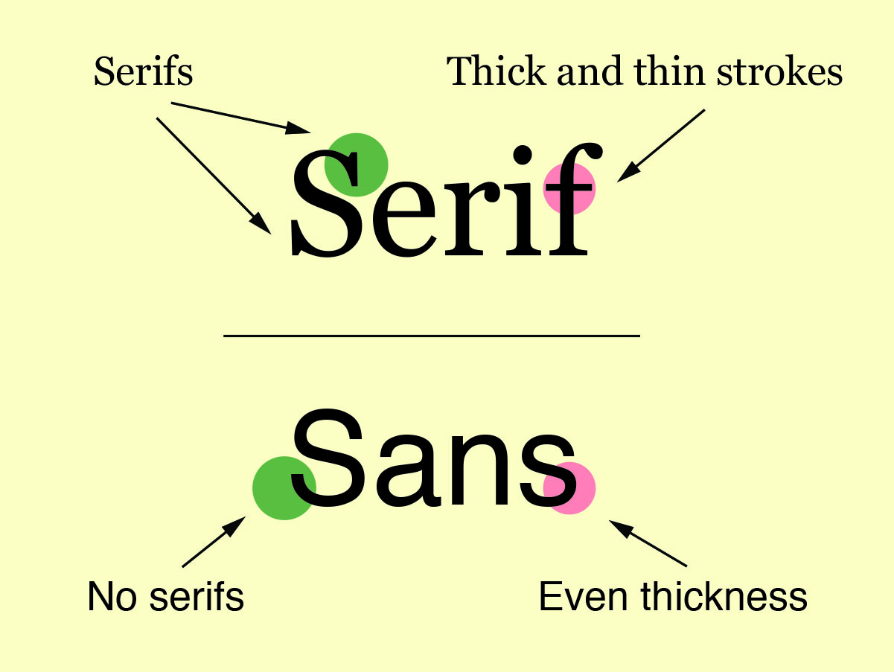

Slide 24
Design tips:
Colors
Use a simple color scheme
Make sure your text stands out from the background color, lighter colors or white backgrounds are best
Busy background patterns can be distracting patterns
Drawing out a color from a photo or image you are using is a good way to pick a color scheme

Slide 25
Images
Use photos, illustrations, charts, and graphs to make your poster appeal to the audience
When using photos or illustrations, make sure they support the ideas of your poster
Simplify charts and graphs so that the audience can understand quickly
Always use captions

Slide 26
Borrowing images from the web
Be careful using images from the web as they can look pixelated on printed documents, use a resolution of between 120 and 300 pixels per inch
Make sure you have permission to use the image or have purchased it, you can cite your source in the image caption
Visit creativecommons.org to search for free images available for all to use
If you are unsure whether or not you should use an image, try the Fair Use Evaluator Tool at librarycopyright.net/resources/fairuse or visit publishing.gmu.edu/communication/copyright

Slide 27


Examples:

Slide 28

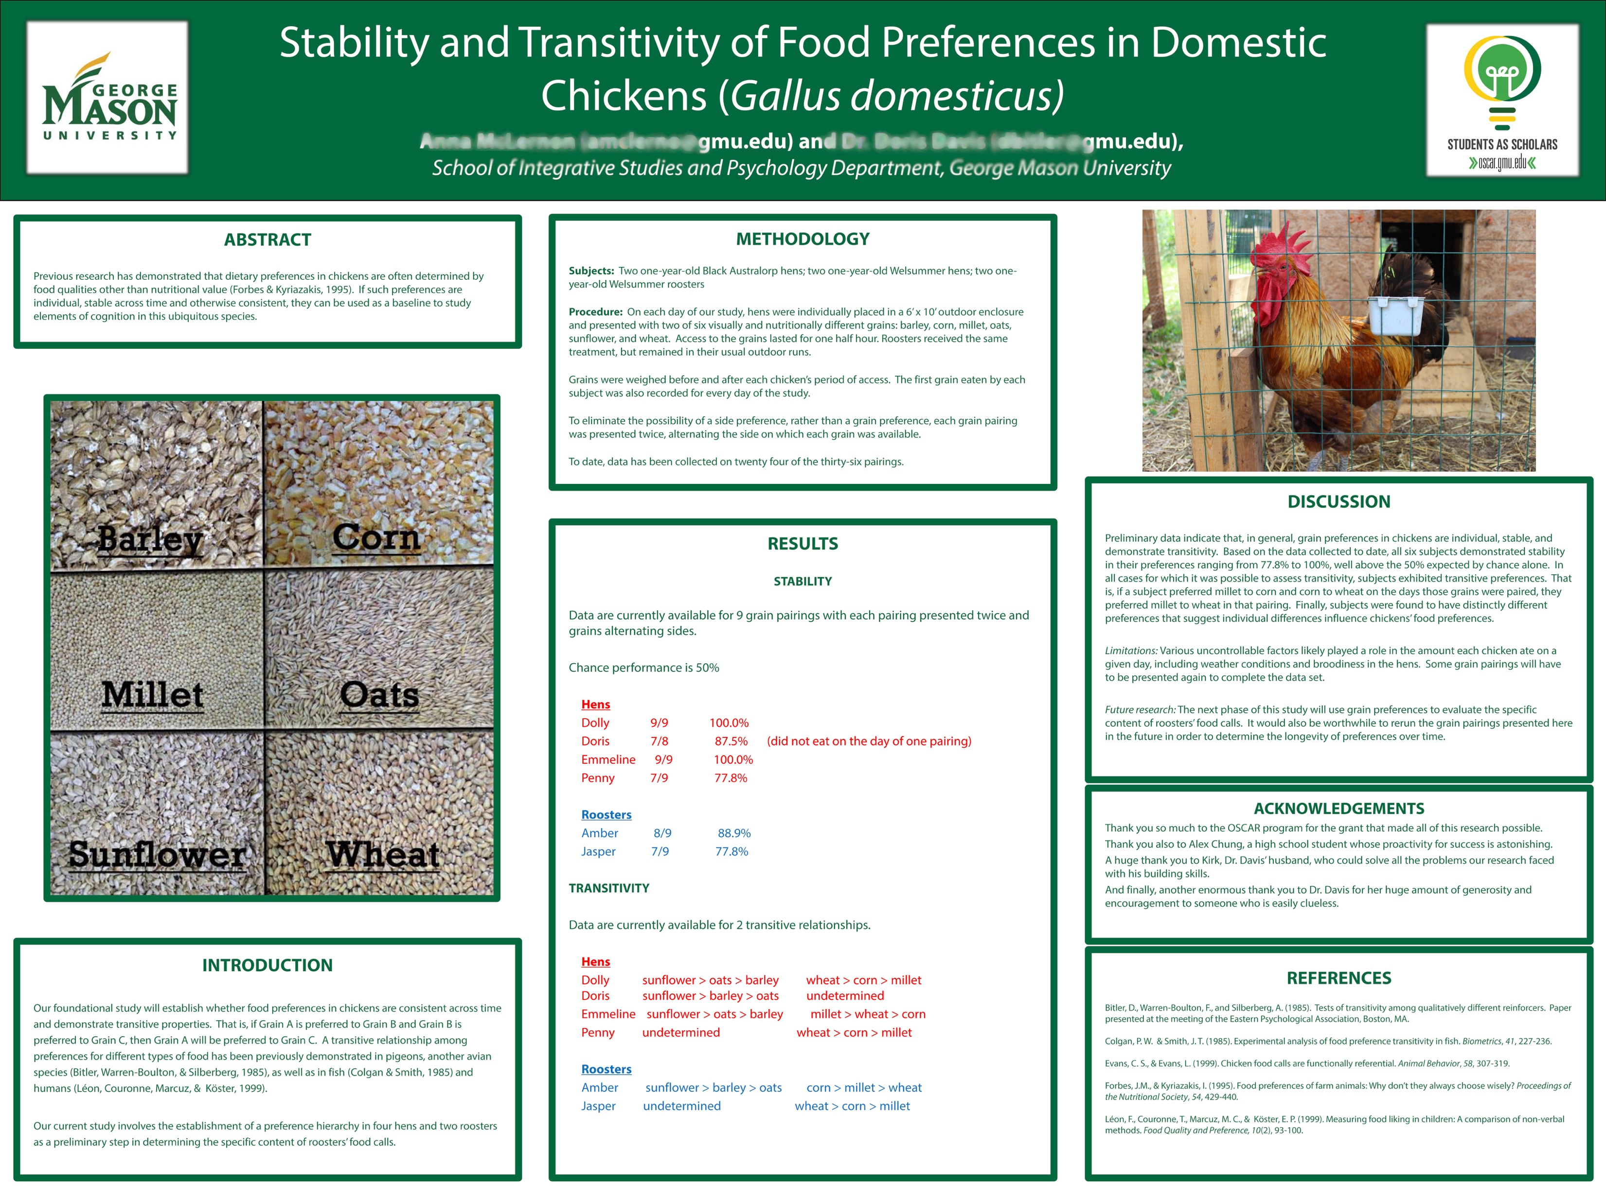

Slide 29



Slide 30

Resources
Scholarly Productions at the Research Commons: http://library.gmu.edu/sparc
The George Mason University Brand Profile: A Guide to Messaging and Visual Identity: http://brand.gmu.edu
Students as Scholars: Professional Poster Presentations: http://oscar.gmu.edu/students/Creating-Posters.cfm
Mason Publishing Group: Copyright FAQs: http://publishing.gmu.edu/communication/copyright-faqs/
Creative Commons: http://creativecommons.org
3 Minute Thesis: https://threeminutethesis.uq.edu.au/

